Slide 1
explAIner: A Visual Analytics Framework for Interactive and Explainable Machine Learning
Reference:
T. Spinner, U. Schlegel, H. Schäfer and M. El-Assady, "explAIner: A Visual Analytics Framework for Interactive and Explainable Machine Learning," in IEEE Transactions on Visualization and Computer Graphics, vol. 26, no. 1, pp. 1064-1074, Jan. 2020, doi: 10.1109/TVCG.2019.2934629.
Link to the paper:
https://ieeexplore.ieee.org/abstract/document/8807299

Slide 2
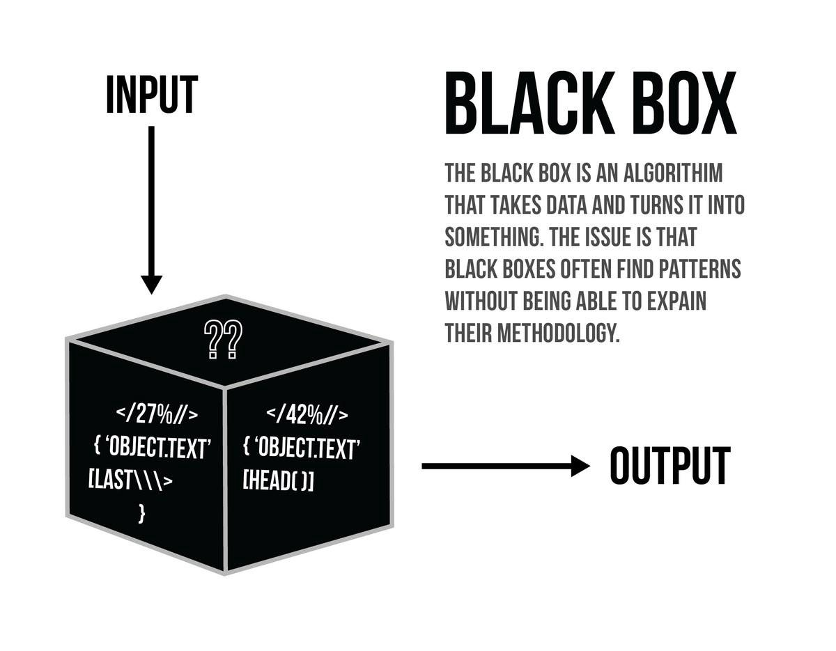
What is the problem?
Since the invention of neural networks in 1940’s, there has been a great increase in AI and ML.
Despite the significant improvement in performance, DL models are considered to be black boxes.
This causes lack of trust on the models.

Slide 3
Importance of XAI
XAI aims to provide human readable as well as interpretable explanations of the decision taken by an ML algorithm.
XAI demands accessible justification and general data protection.

Slide 4
Method Proposed
In this paper, they propose a visual analytics framework for interactive and explainable ML .
Their work is mainly targeted on 3 user groups,
Model Developers
Model Users
Model Novices.

Slide 5
Recent Research
As recent studies confirms that, most people who are involved in model usage and development, they are familiar with the concepts of XAI and other do not.
In this paper, they decided to integrate the proposed system to TensorBoard.
The system provides an iterative exploration of the model graph and visualization.

Slide 6
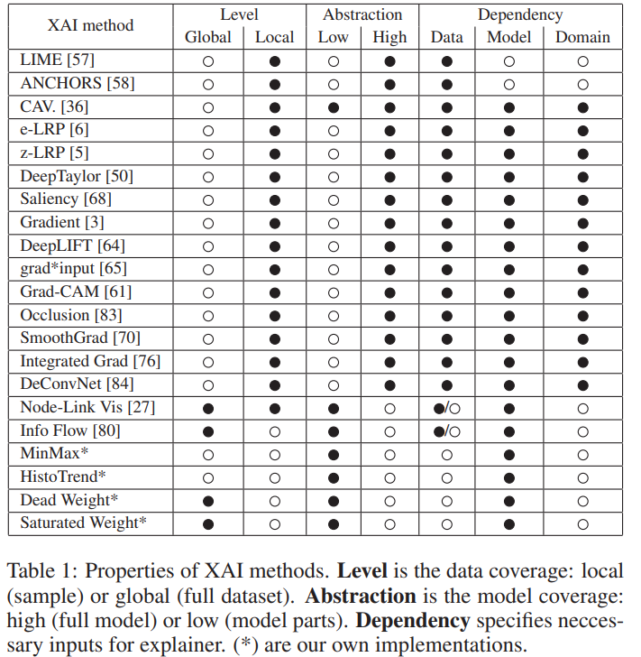
Approaches for Explainable AI
The popular method is Local Interpretable Model Agnostic Explanations.
Another technique called ANCHORS, focus the most influential areas.
These listed approaches provide only some XAI workflow.

Slide 7
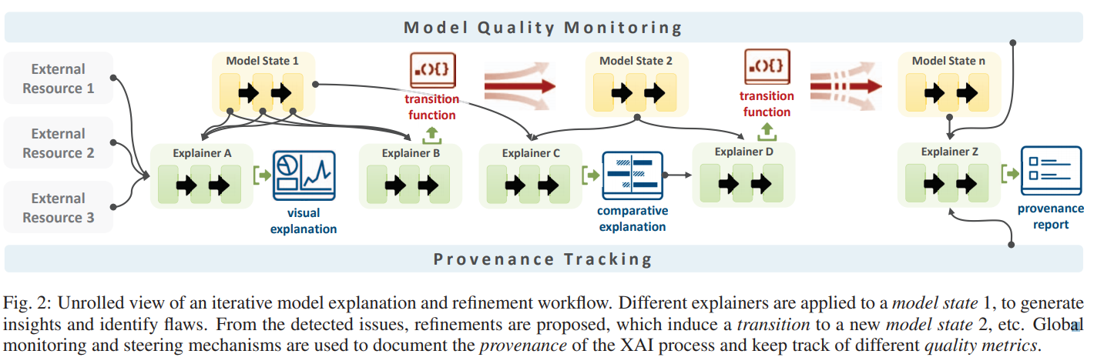
Conceptual Framework

Slide 8
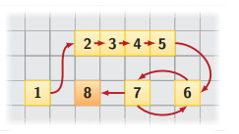
XAI Pipeline
Multiple model states and multiple explainers.
Model state is one configuration of a trained ML model with given parameters.
To find an optimal model, we consider the search space that spans all the possible model states.

Slide 9
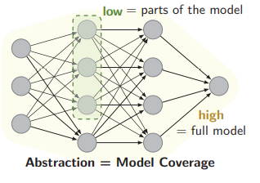
Explainer Abstraction
It is defined as the model coverage (ie), a low abstraction only considers a part of the model, while high abstraction considers the whole model.

Slide 10
Output of explainers
Generally the output of explainers will be,
Explainable - Interactive visualization and verbalization.
Transition functions - Used to understand and diagnose (XAI)

Slide 11
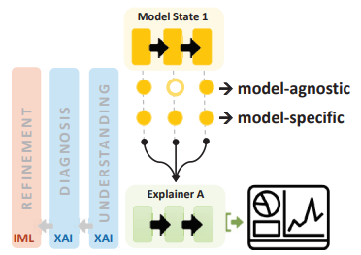
Single model Explainer
These model-specific explainers are particularly useful for model developers as they can help in diagnosing the internal structure of a model.
These explainers are particularly useful for model novices and model users in machine learning.

Slide 12
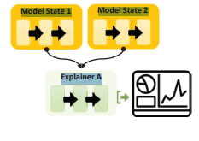
Multi Model Explainer
Complementary to single model explainers, multi-model ones are primarily used for the comparative analysis of model states

Slide 13
Global Monitoring and steering Mechanisms
Model quality monitoring
Data shift scoring
Search space Exploration
Comparative analysis
XAI Strategies
Provenancetracking
Report and trust building
Knowledge generation

Slide 14
Use cases
The proposed system is tested by giving access to three types of people.
Case 1: Computer science freshman
Case 2: Biologists
Case 3: Researchers

Slide 15
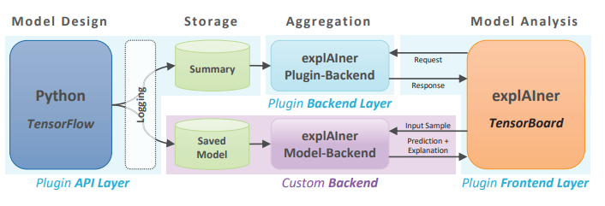
System Design and implementation

Slide 16
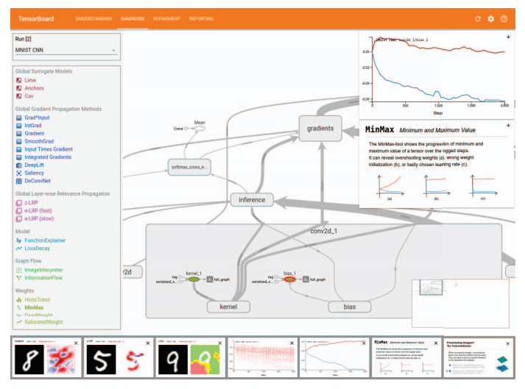
Diagnosis dashboard
Available Videos: https://vimeo.com/360154764
https://vimeo.com/368699132
They extend the tensorboard by 4 additional dashboard views.
Understanding
Diagnosis
Refinement
Reporting

Slide 17
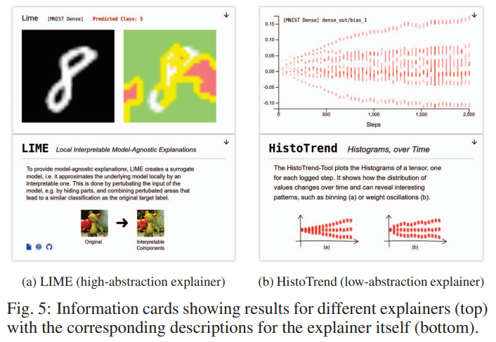
Understanding

Slide 18
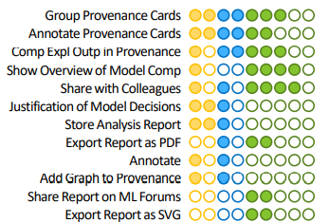
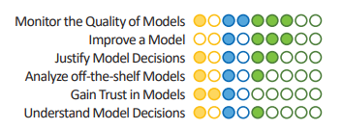
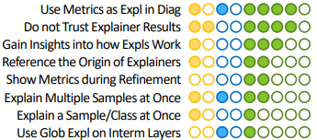


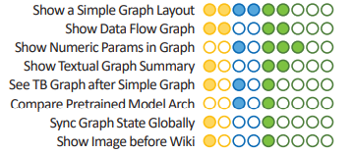
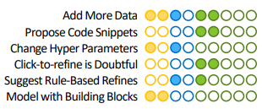
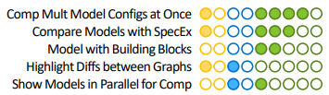
User Study

Slide 19
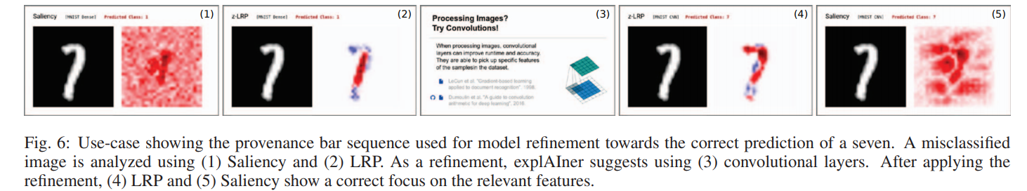
Evaluation

Slide 20
Feedback
Overall, the feedback on the system design was positive
Common feature requests in this direction focus on additional user guidance in the form of tutorials, suggestions, checklists, information with more labels, and example models

Slide 21
Future Work
The most requested functionality is a simplified representation of graph model.
Most commonly requested was an additional view to enable direct comparative analytics as well as the speculative execution of proposed refinements

Slide 22
Conclusion
A framework for interactive and explainable machine learning, capturing the theoretical and practical state-of-the art in the field.
They defined the XAI pipeline, which maps the XAI process to an iterative workflow of three stages:
model understanding, diagnosis, and refinement
The users found this system to be intuitive and helpful and considered an integration in their daily workflow

Slide 23
Thanks!

